Slide 1
Մաս 4
Կոմպոզիցիա

Slide 2
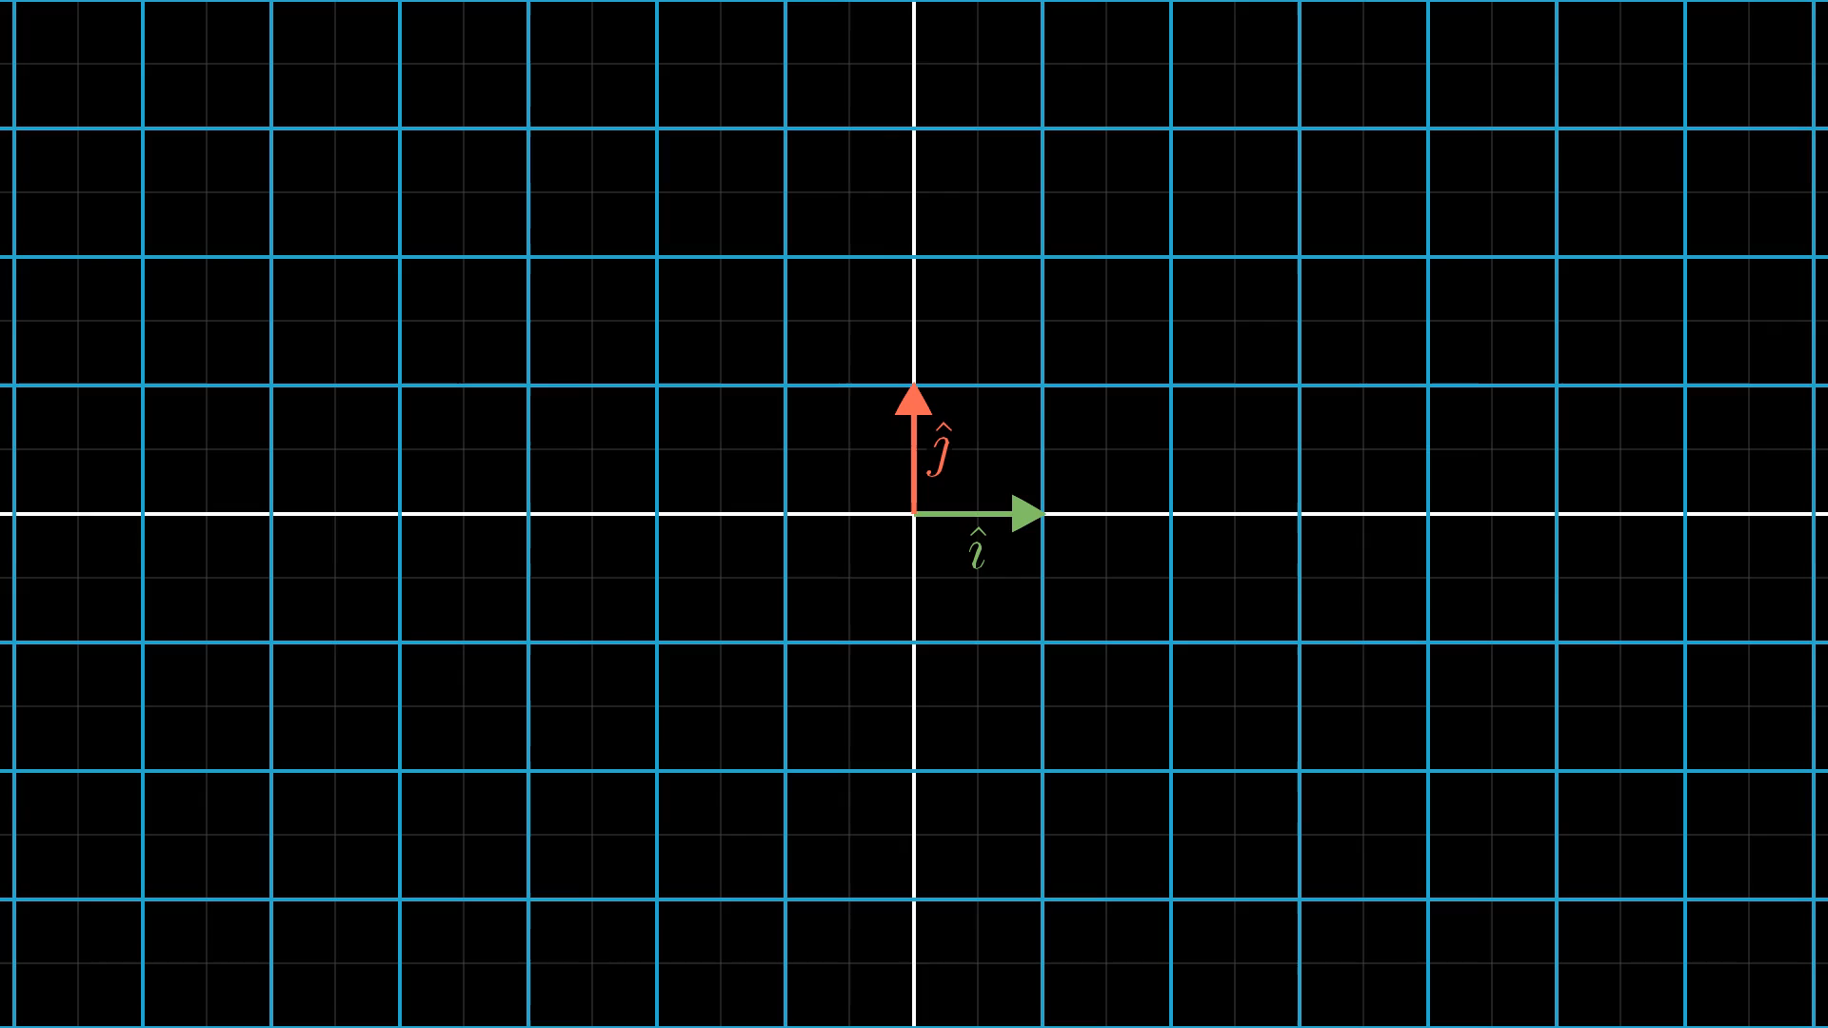
Notes:
Follow basis vectors

Slide 3
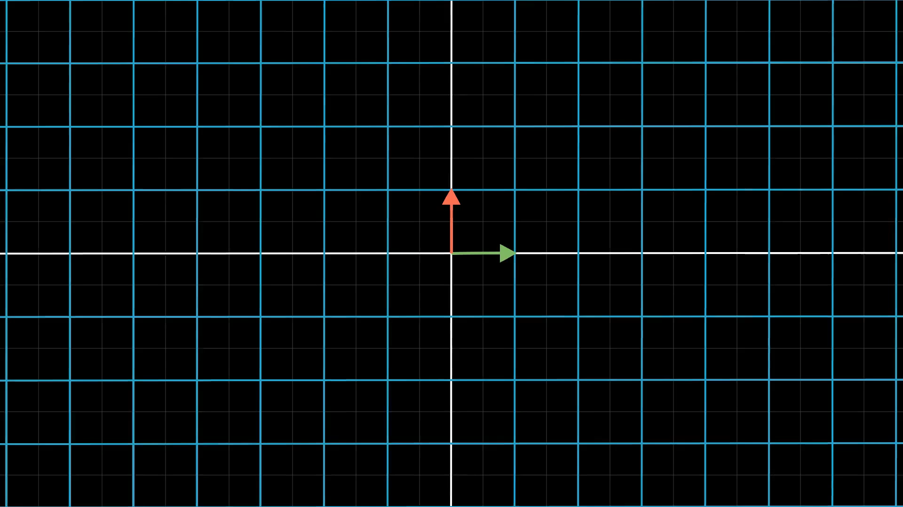
Notes:
Two successive transformations

Slide 4
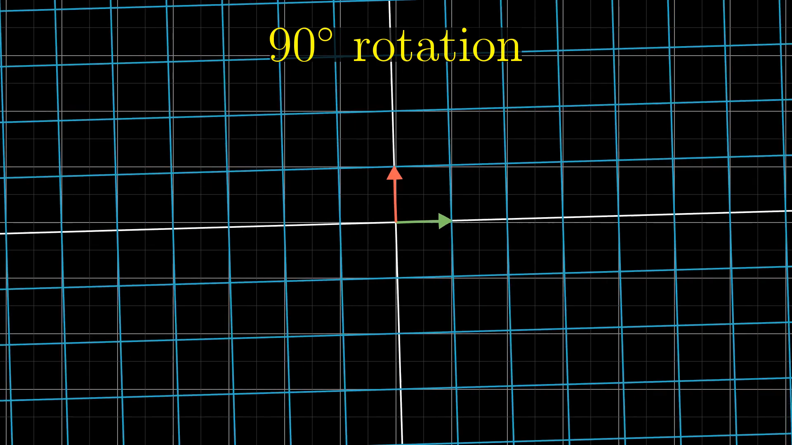

Slide 5
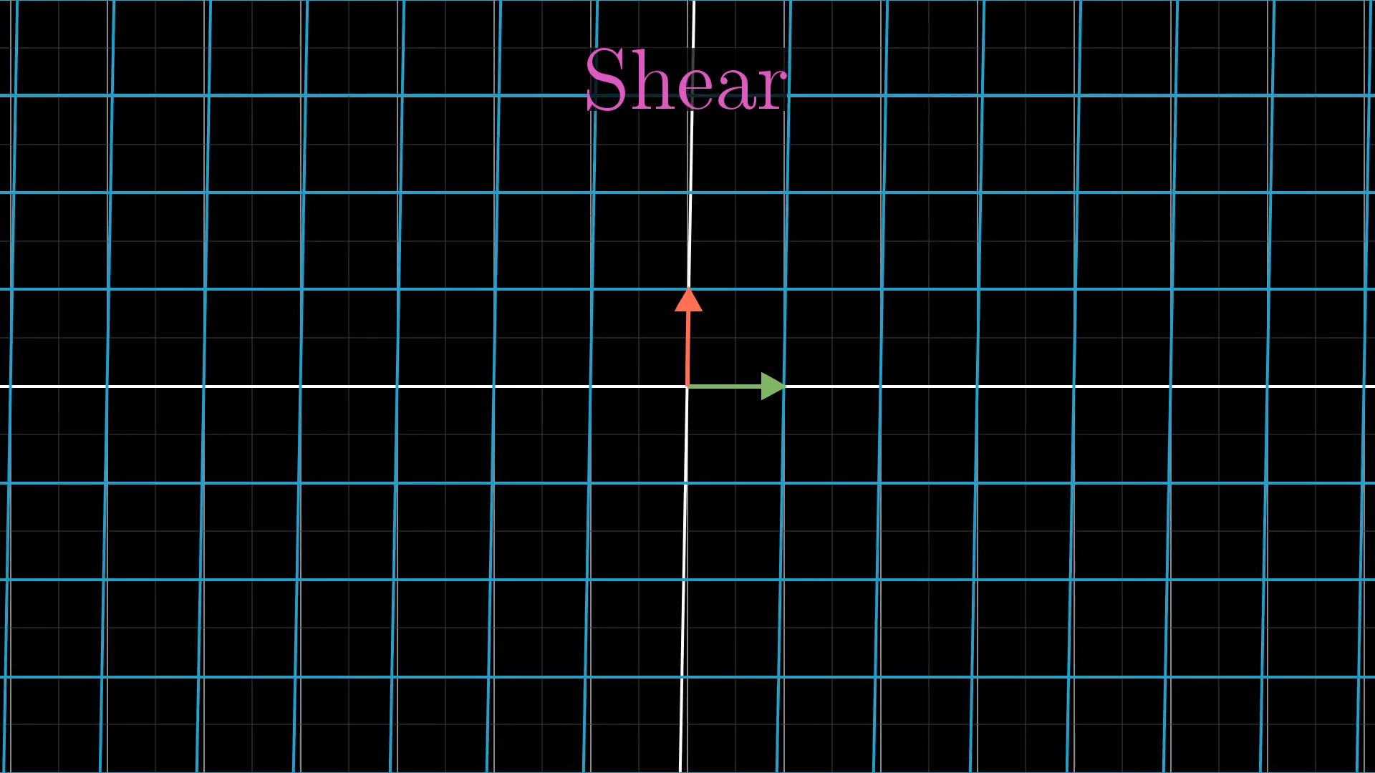

Slide 6
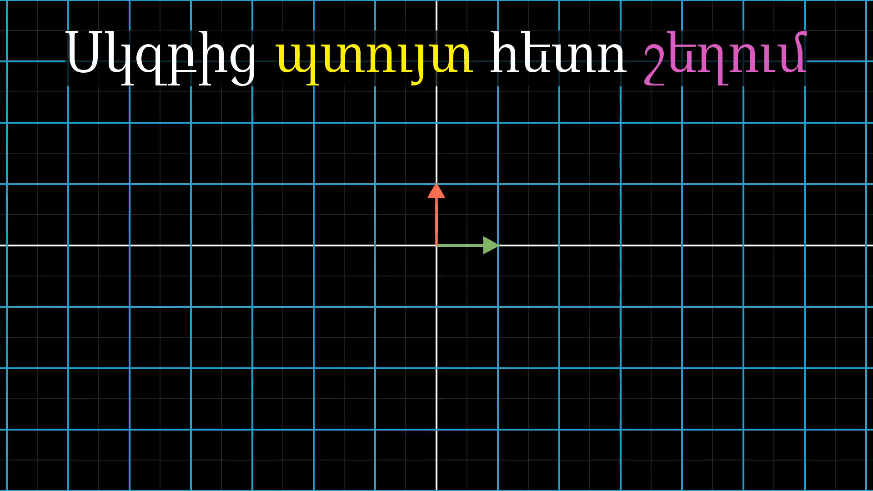
Notes:
Rotation then shear

Slide 7
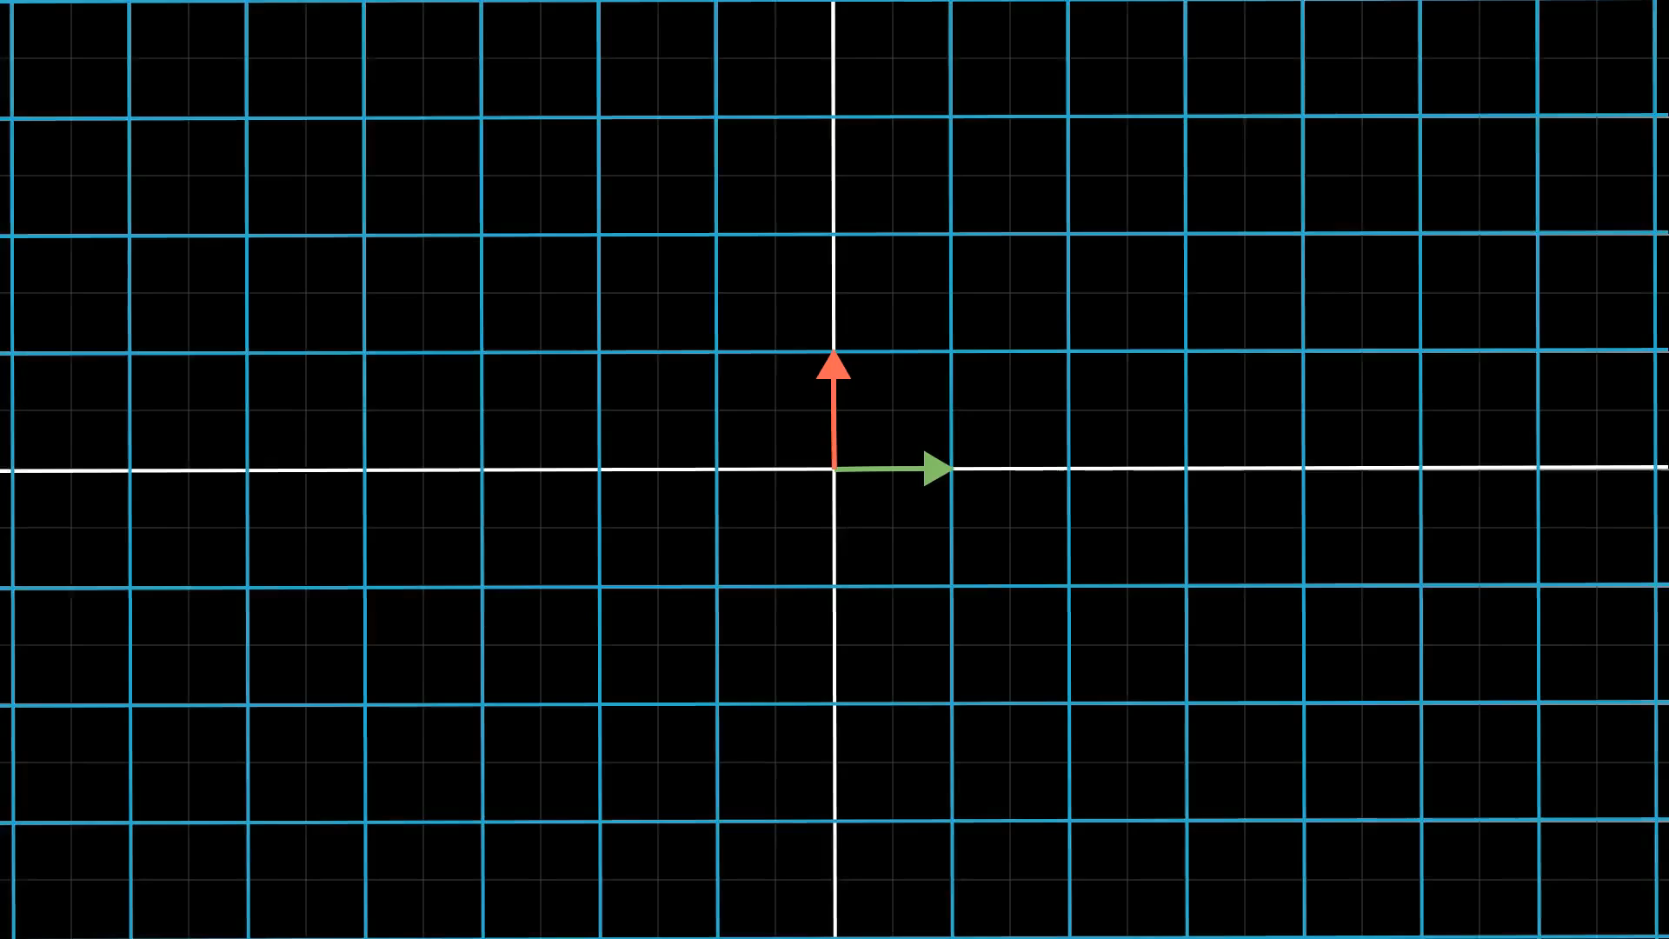
Notes:
Introduce idea of combinations

Slide 8
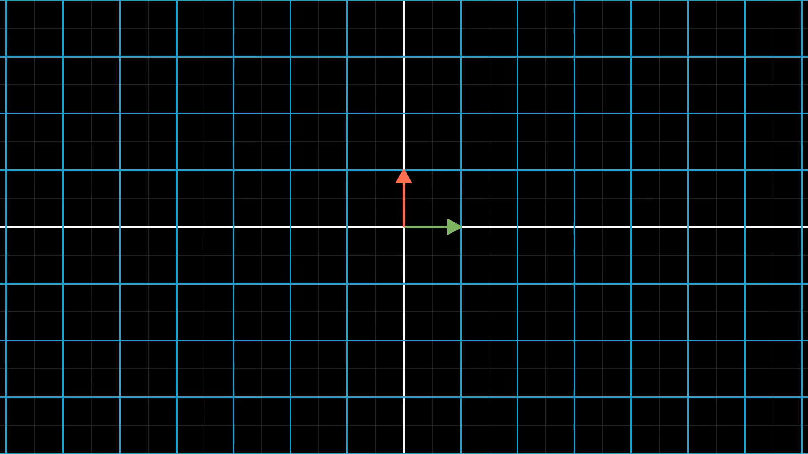
Notes:
Pump vector throw rotation then shear

Slide 9
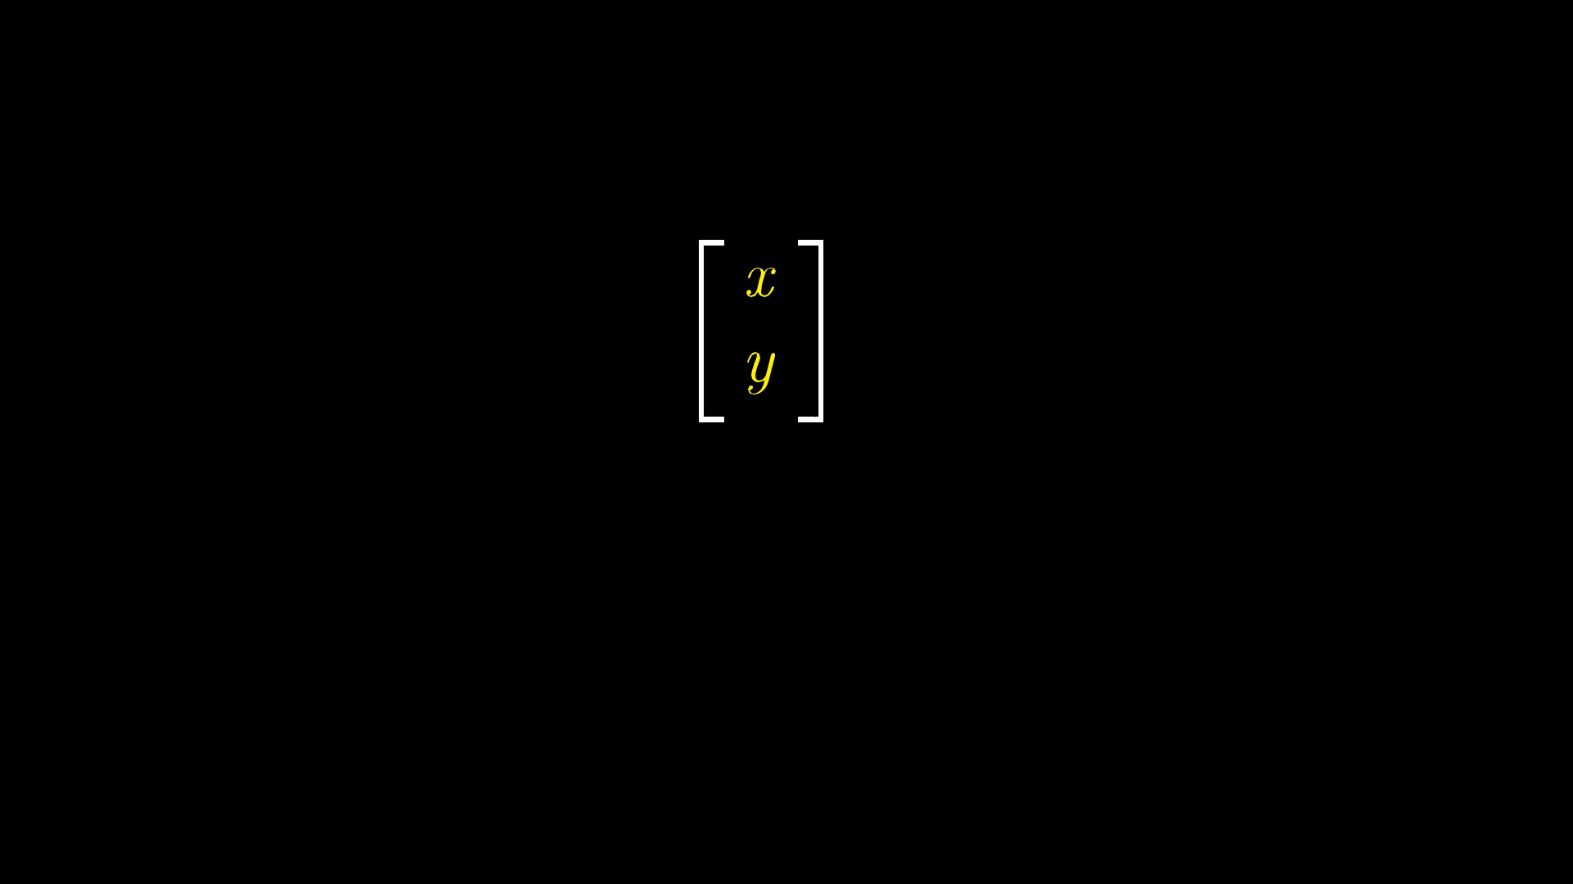
Notes:
Explain why it is matrix multiplication

Slide 10
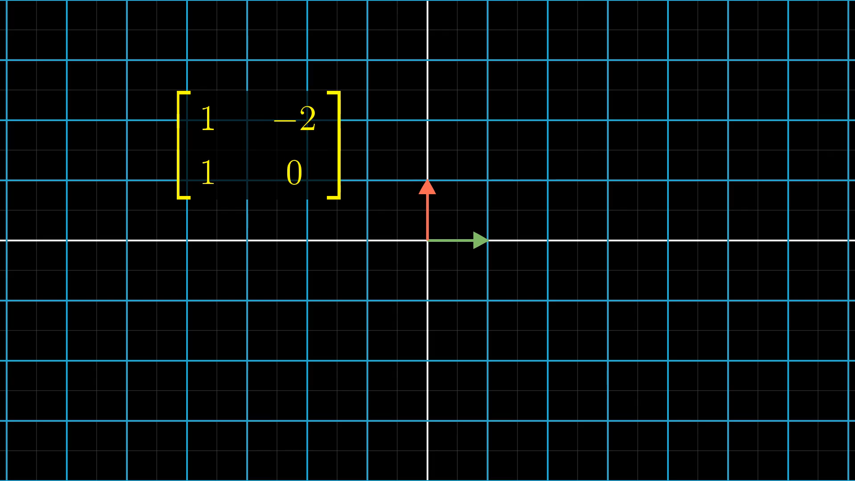
Notes:
More complicated example

Slide 11
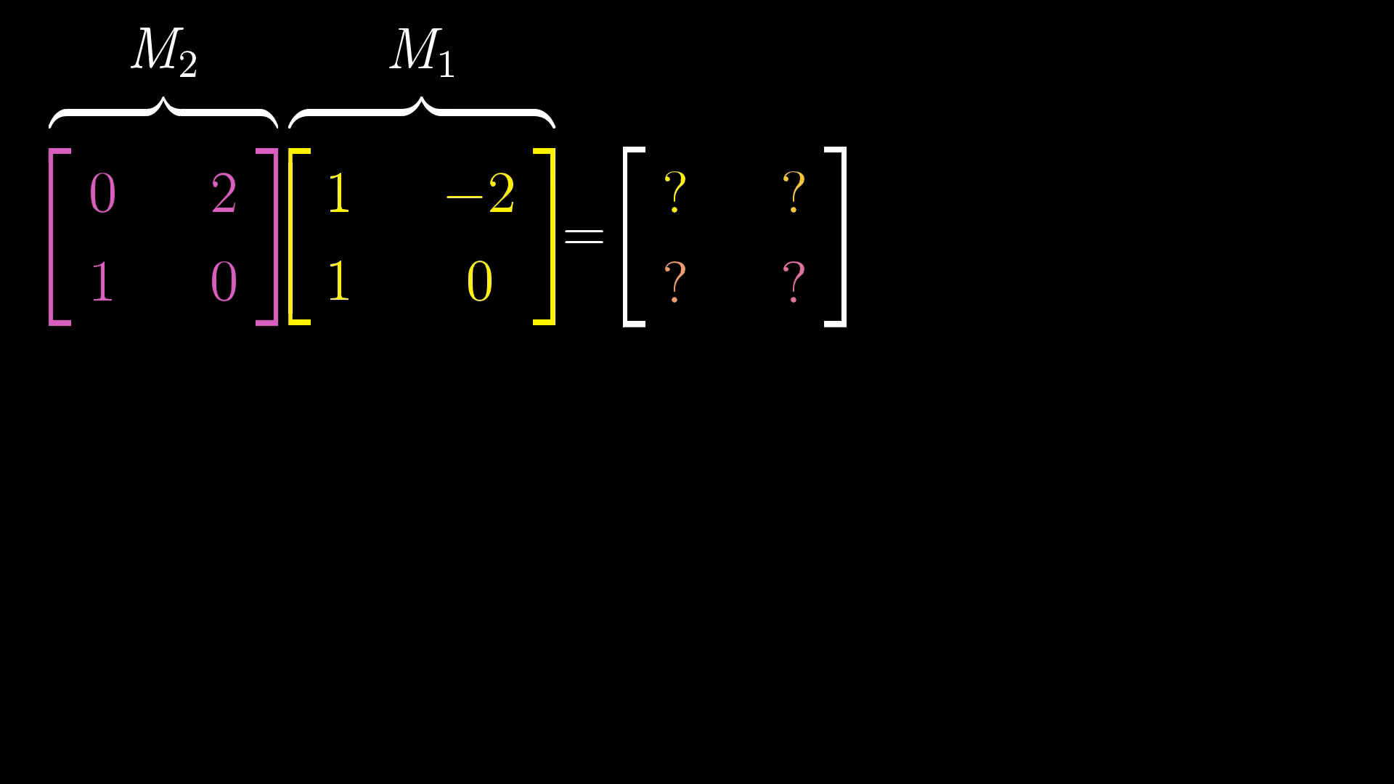
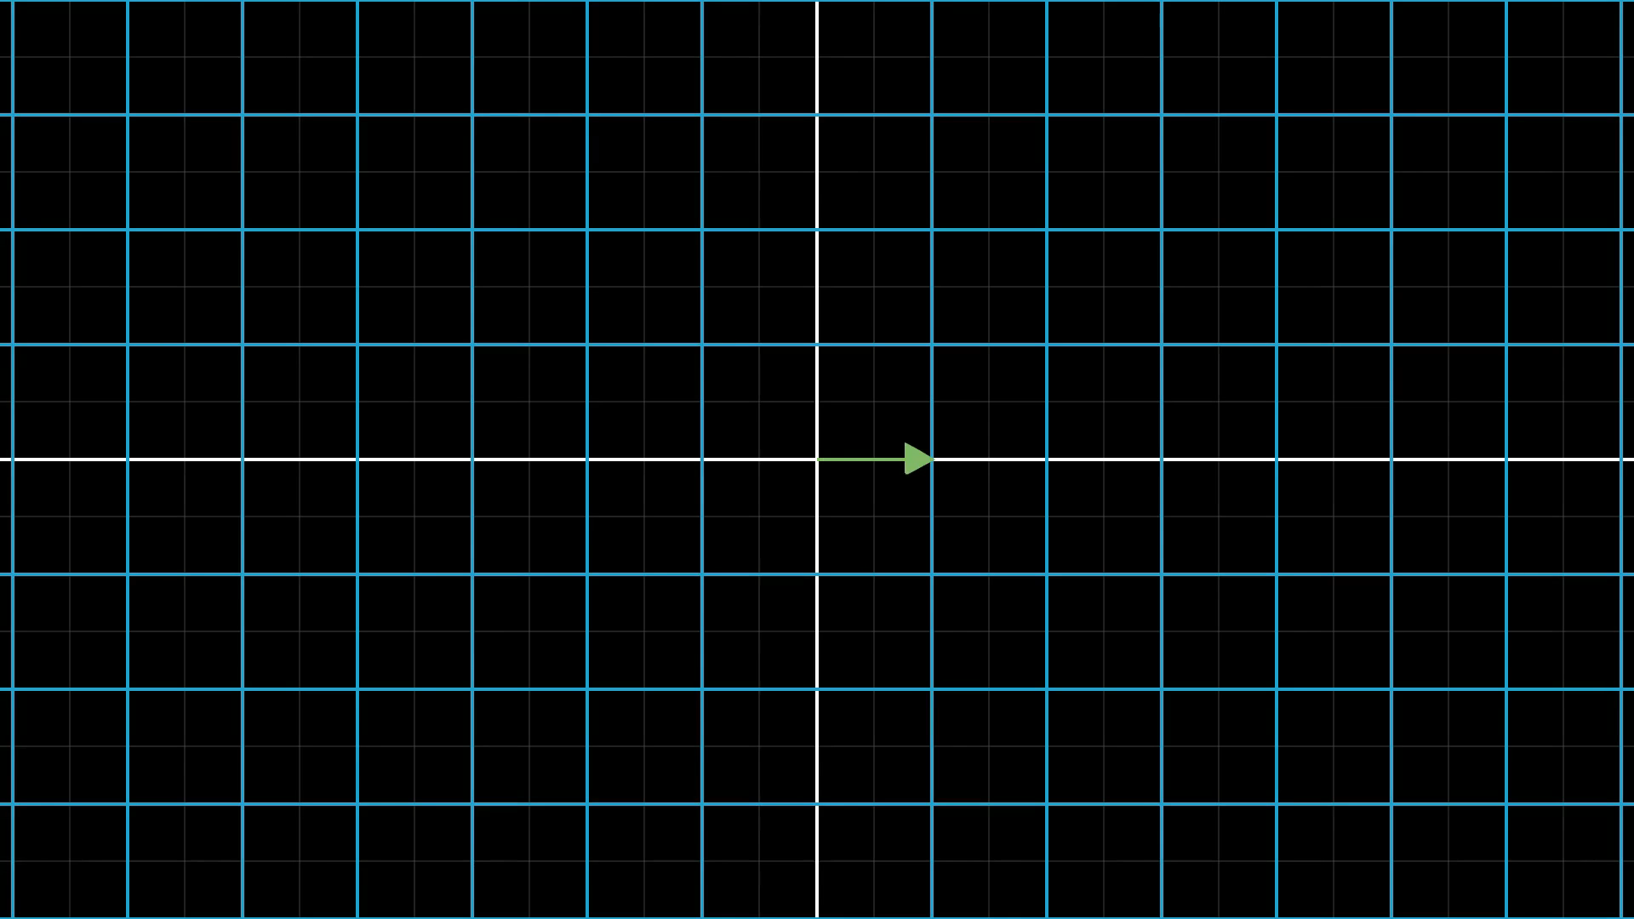
Notes:
More complicated example numerically for i hat

Slide 12
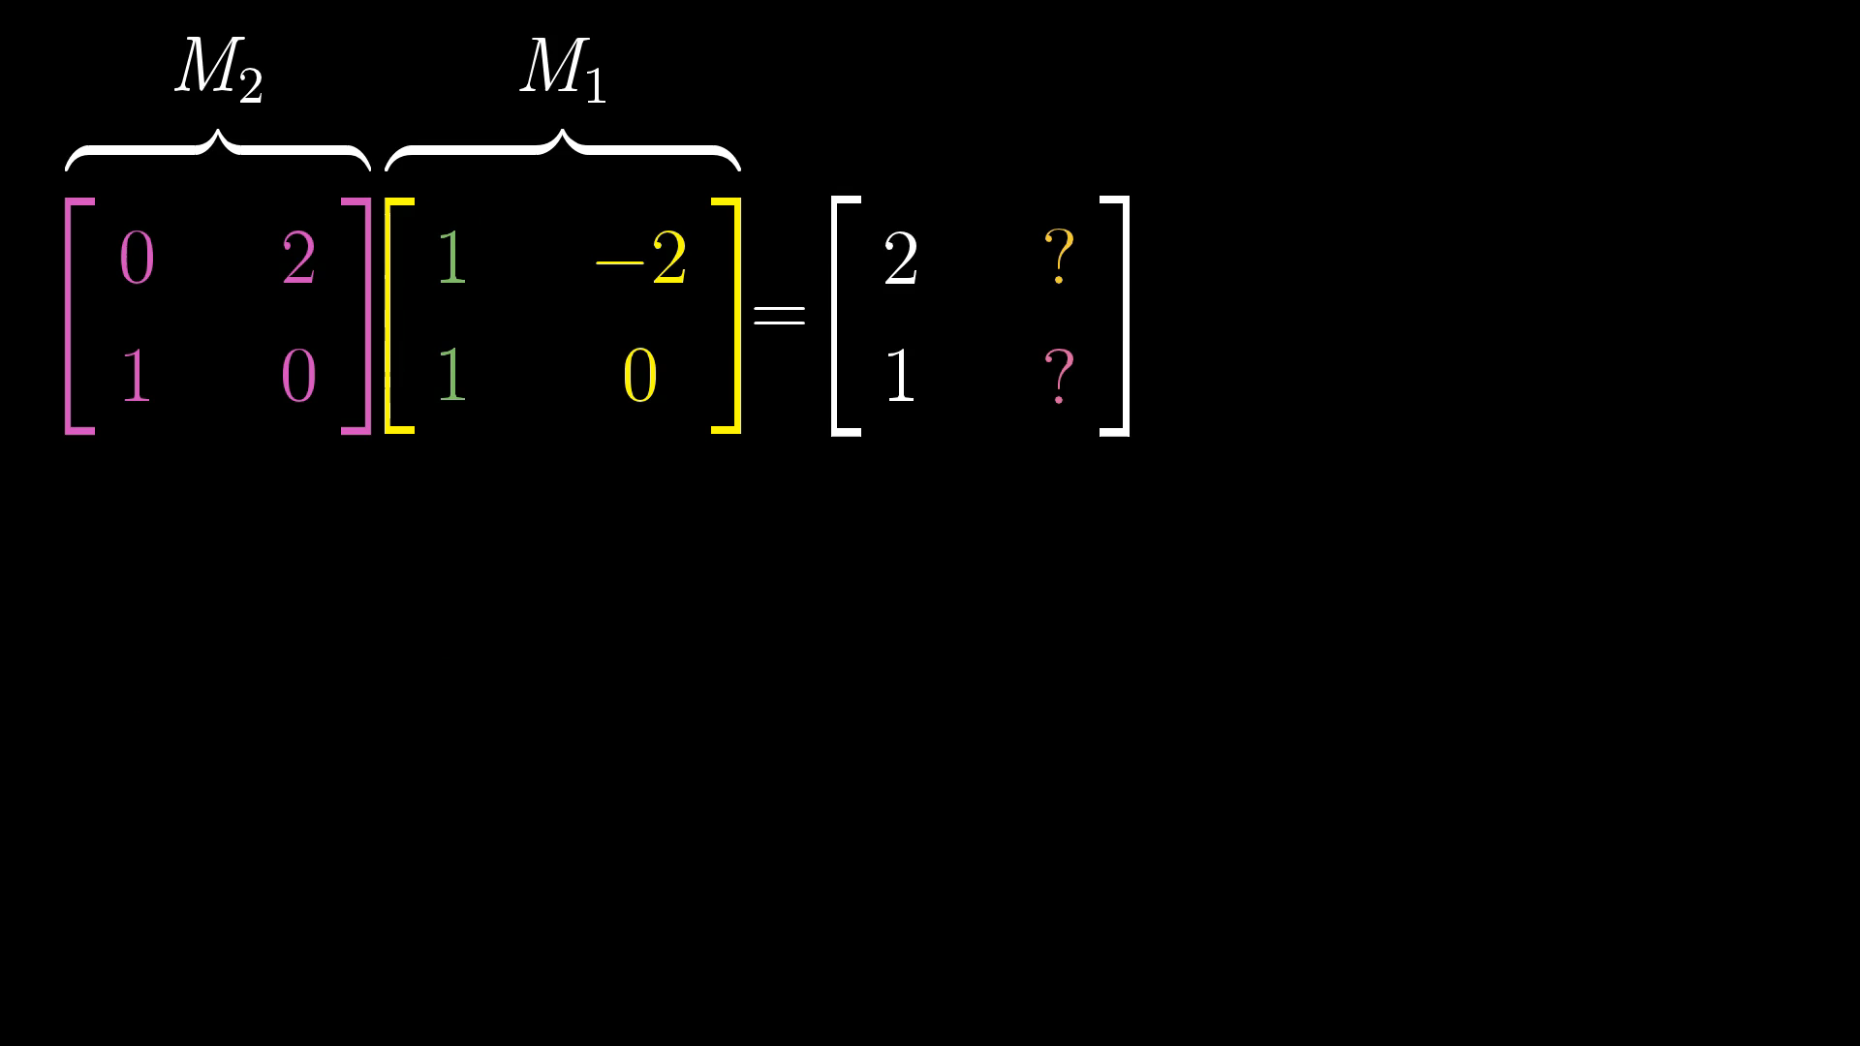
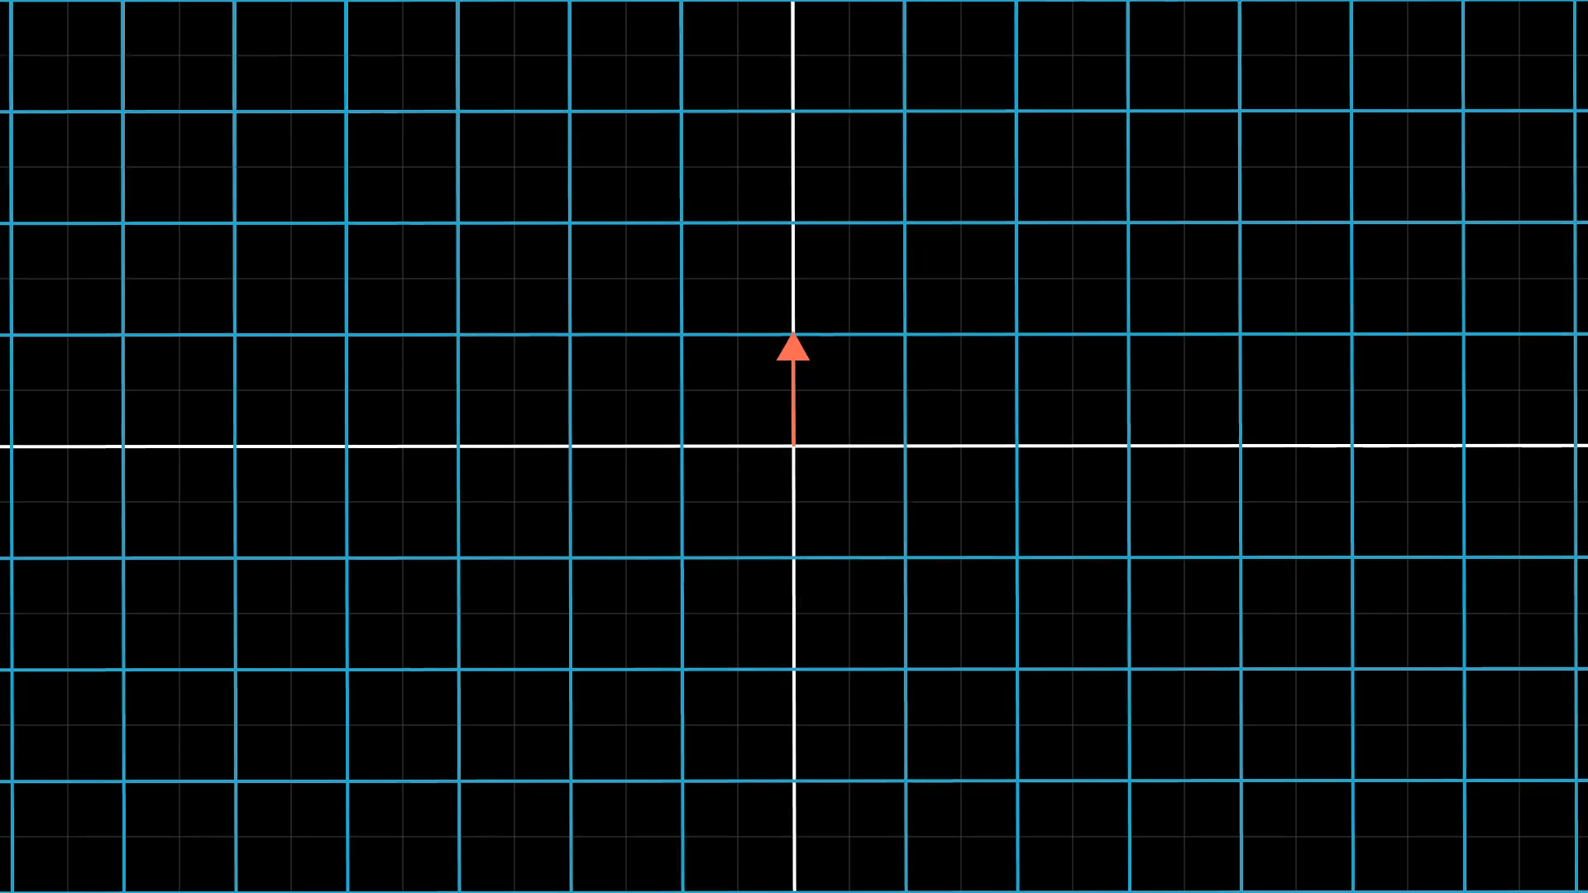
Notes:
More complicated example numerically for j hat

Slide 13
Notes:
Transform only I hat

Slide 14
Notes:
Transform j hat

Slide 15

Notes:
General formula

Slide 16
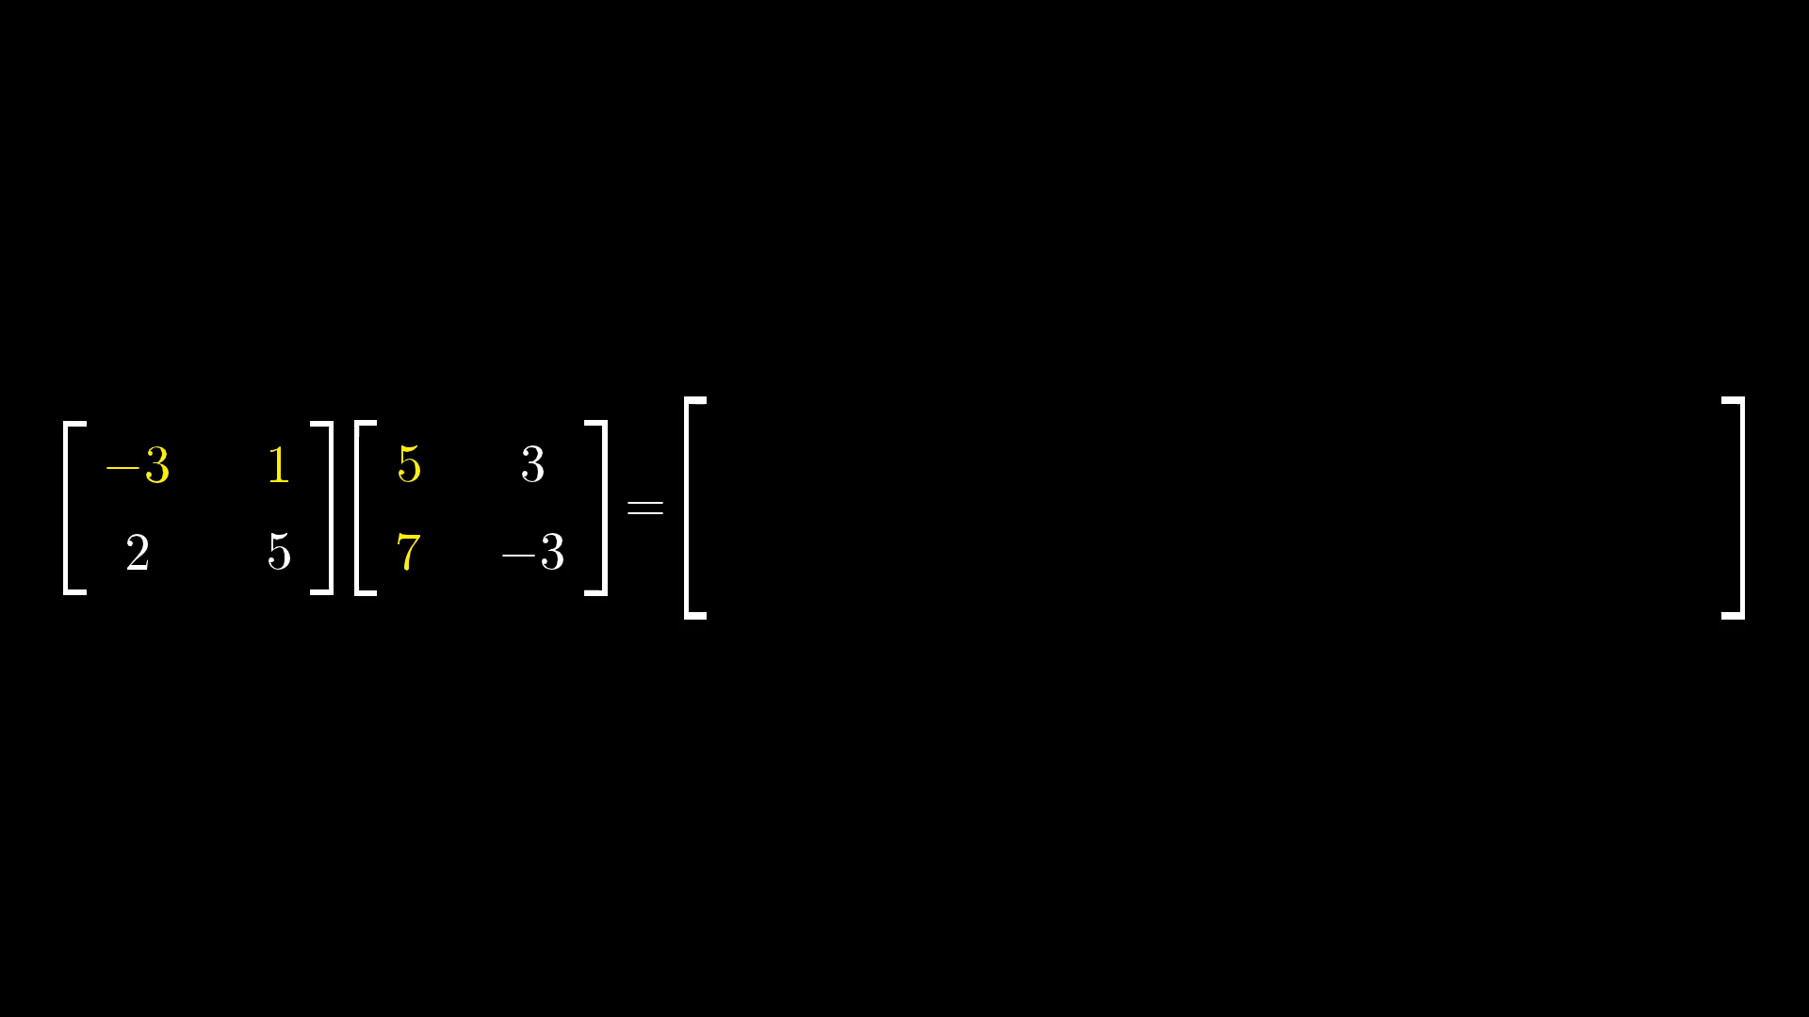
Notes:
Rotematrix multiplcation

Slide 17
Notes:
Transform vector

Slide 18

Notes:
Ask about commutativity

Slide 19
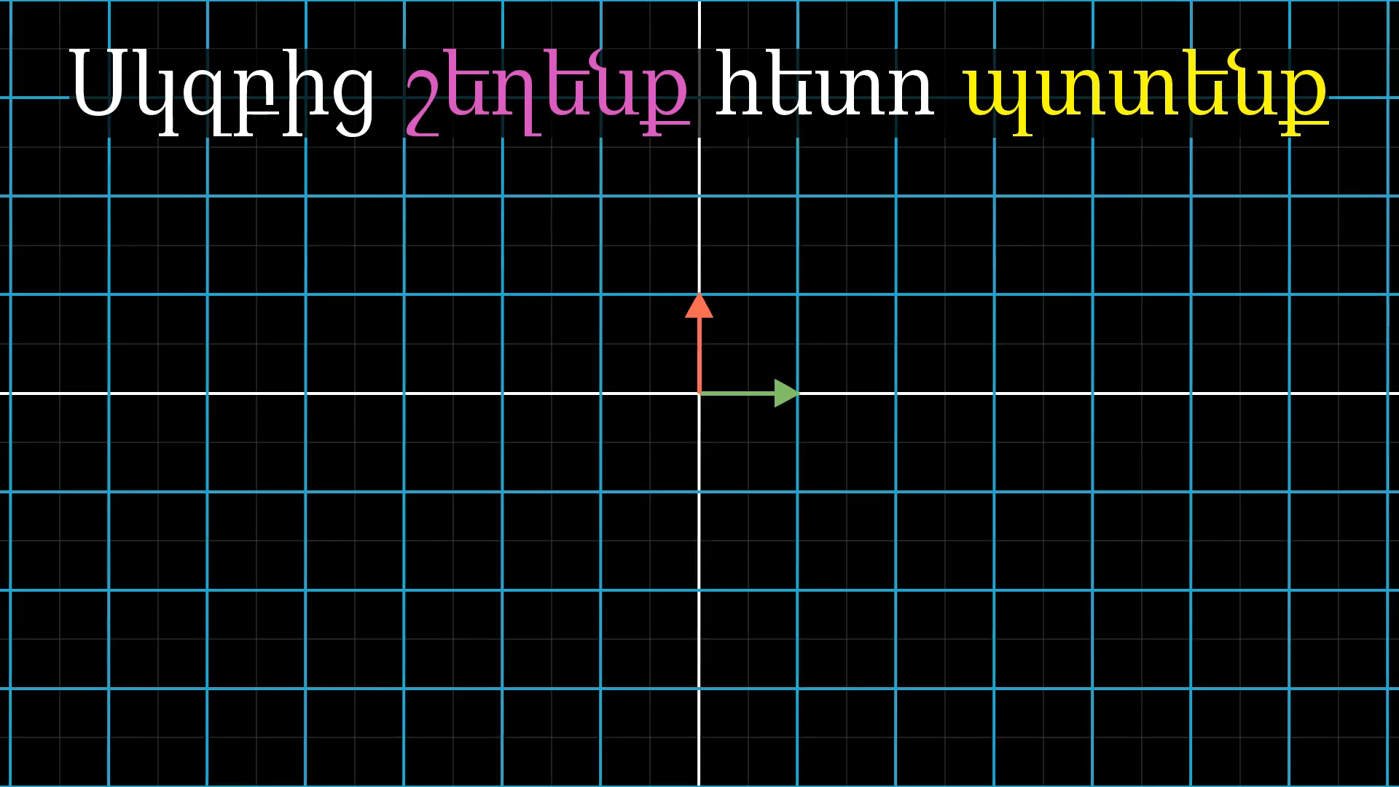
Notes:
First shear then rotation

Slide 20
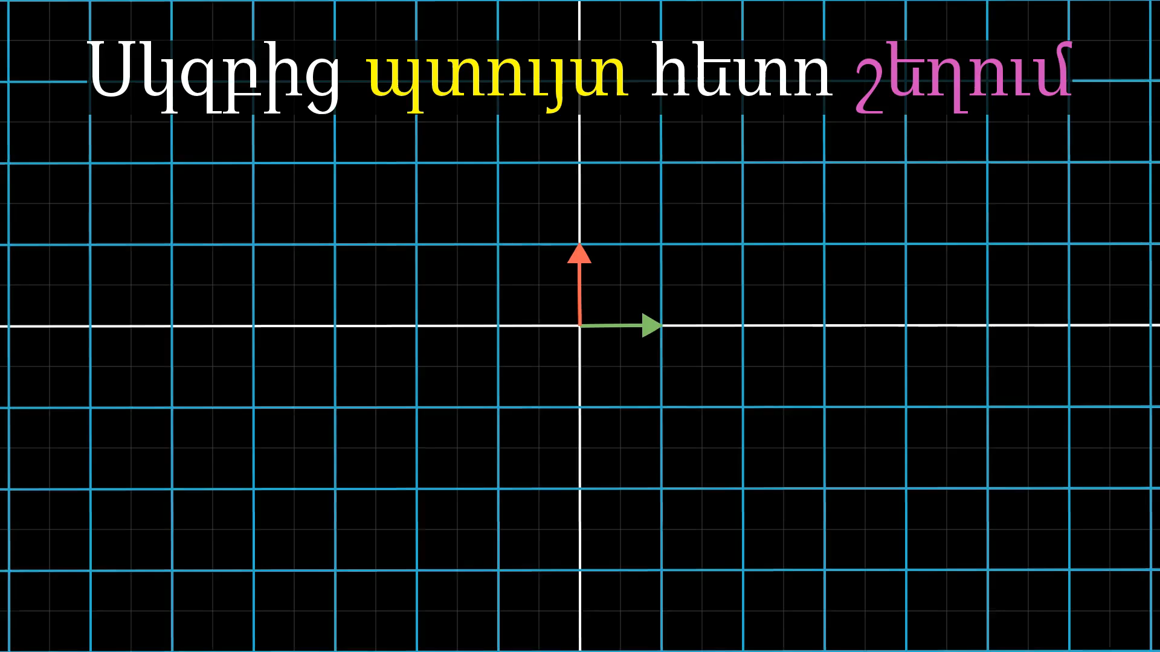
Notes:
First rotation then shear

Slide 21
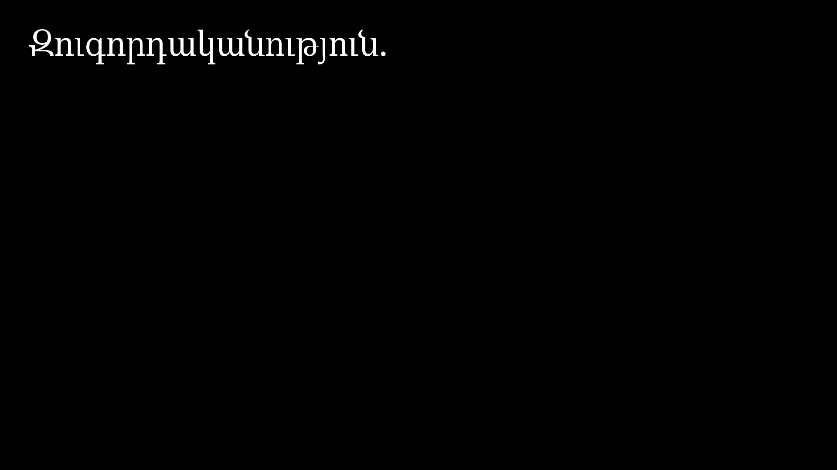
Notes:
Ask associativity question

Slide 22
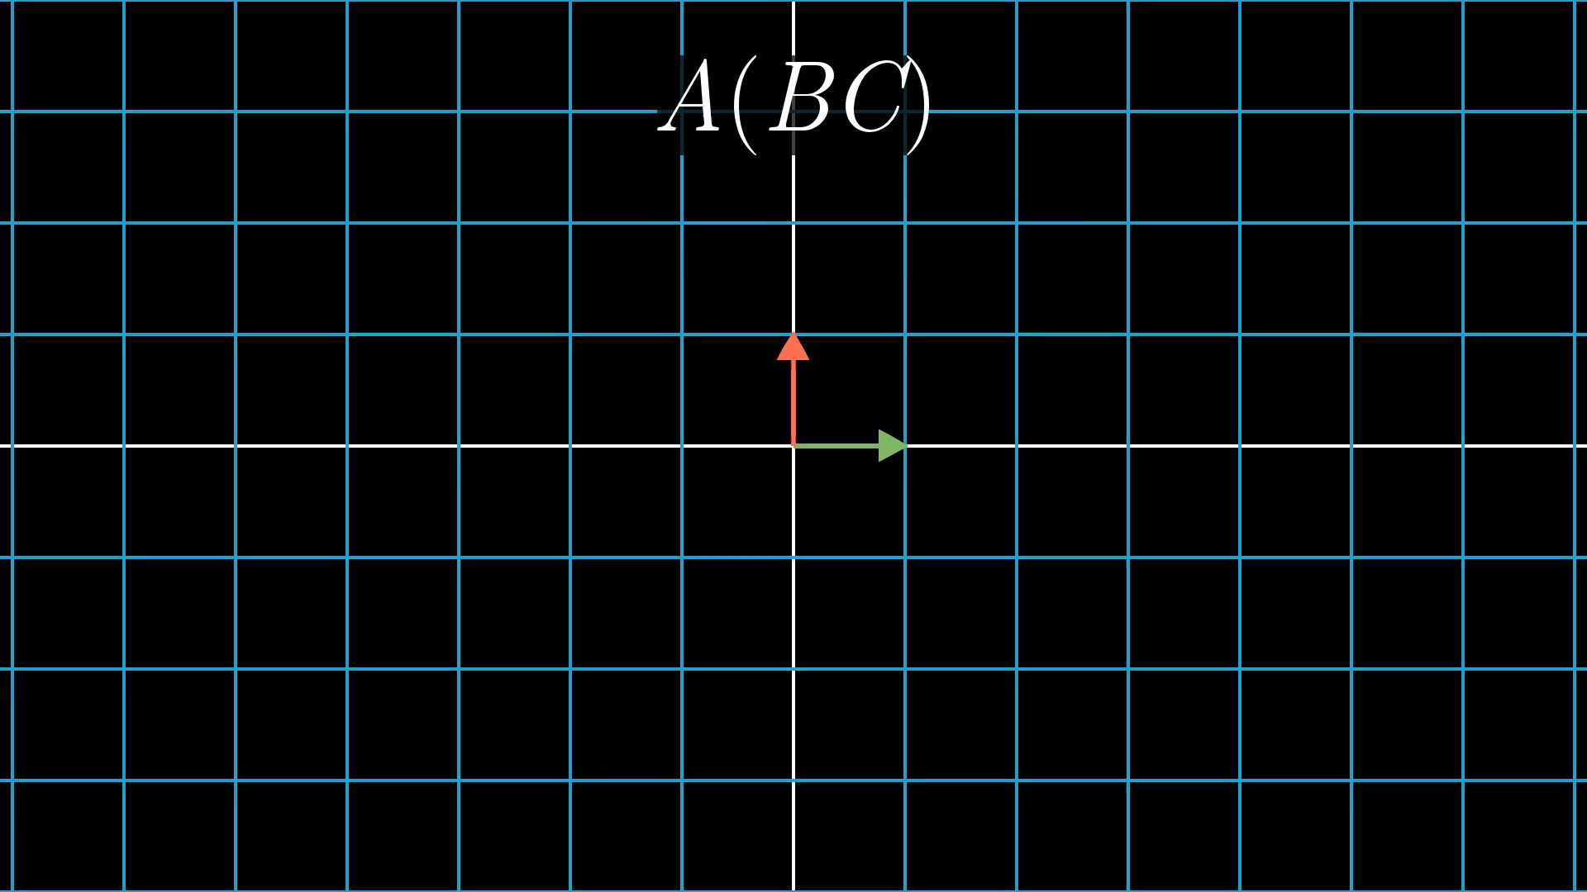
Notes:
Three successive transformations

Slide 23
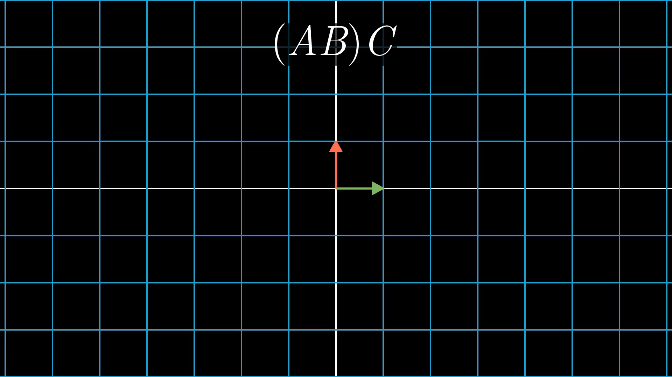
Notes:
Three successive transformations

Slide 24
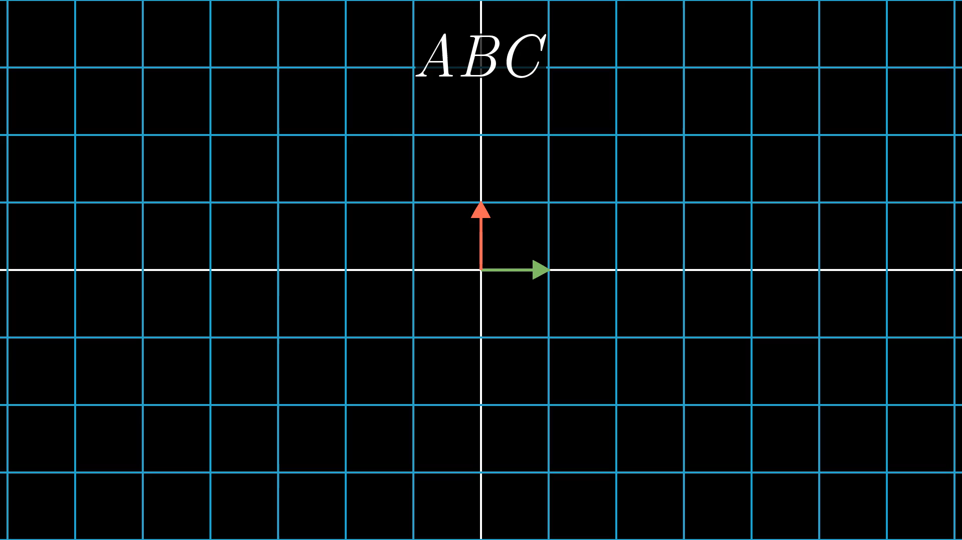
Notes:
Three successive transformations

